Slide 1
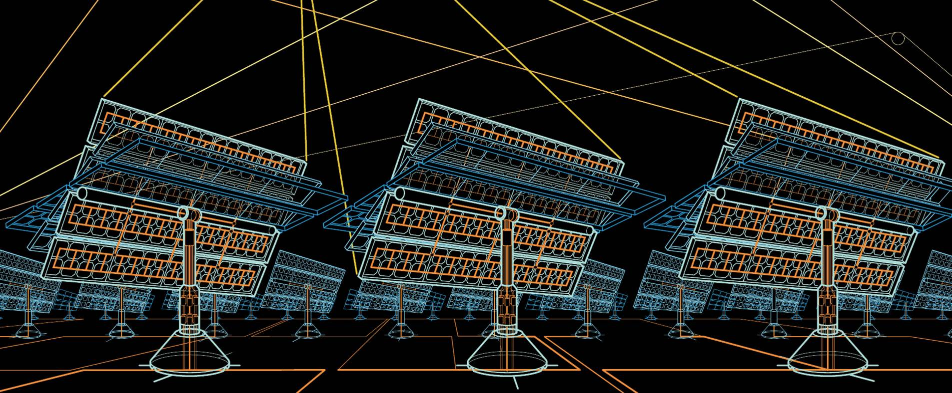
Cloud Tracking System for KACTS Proposal for Testing
Luis Dominguez, ABB Corporate Research Centre

Slide 2
Cloud Tracking System
The Vision-based Sky Monitoring (VISMO) System consist of:
An automated camera and wide-angle-lens system with specialized algorithms for cloud detection, tracking and prediction.
Sensors for ambient temperature, wind speed, humidity if not already available at the research facility.
Sensors for global (GHI) and local (DNI) irradiation for monitoring the spatial distribution of irradiation within the site.
The system is intended to aid in the operation of the desalination plant by providing a information regarding the number and location of the trackers that will be occluded ahead of a particular time (e.g. short-term forecast with a 3-6 min horizon length) and the approximate duration of the occlusion. Provided that a model for the trackers and inverter is available, an estimated prediction of the amount of power that can be generated or lost for each tracker could be given by our system. With this information, an estimate of the generated power can be provided for the entire plant.

Slide 3
Cloud Tracking System
Proposed Location – 2D View
PV Installation
Cloud Tracking System Location:
Corner of KACST Research Station

Slide 4
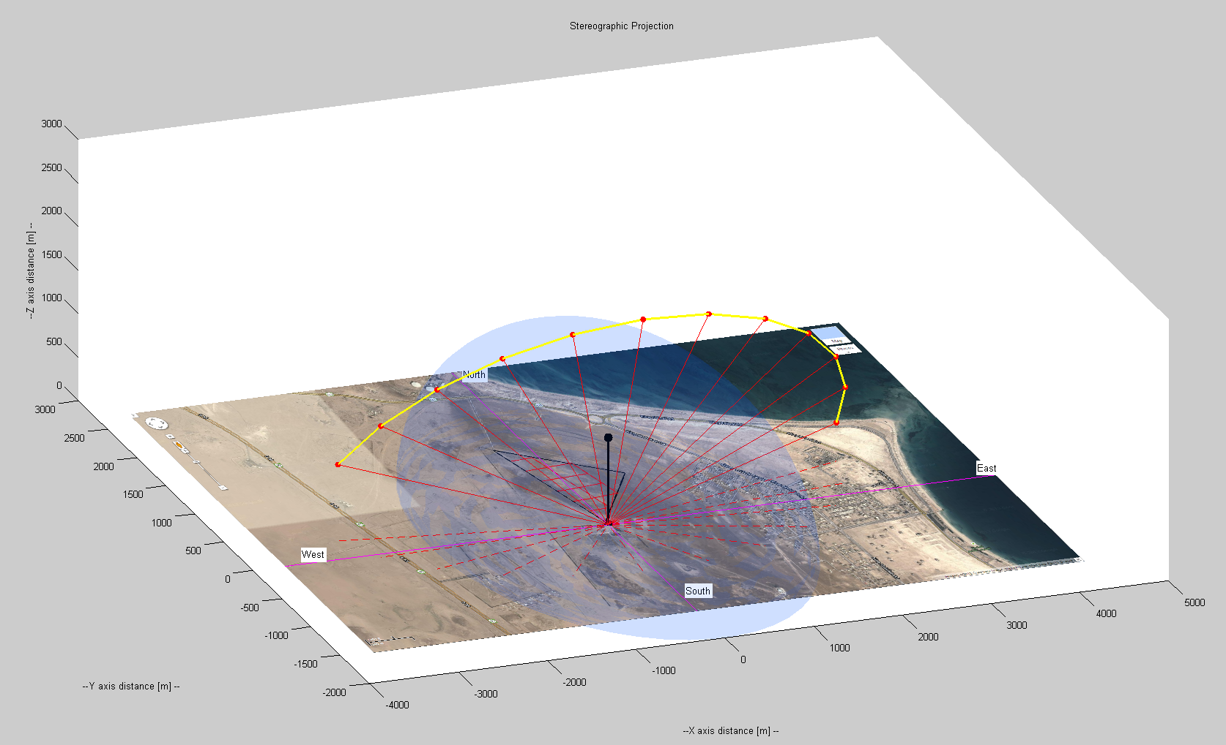
Cloud Tracking System
Approximate Area Cover – 3D View
Sun Trajectory for August 18, 2013
6 am to 5 pm
Sun Zenith Angle Forecast
Cloud Base Height (CBH)
Area cover will depend on cloud altitudes experienced at the particular location
6:00 am
5:00 pm
Sun Azimuthal Angle Forecast
Cloud Tracking System Field of View
180 ° x 180 °

Slide 5
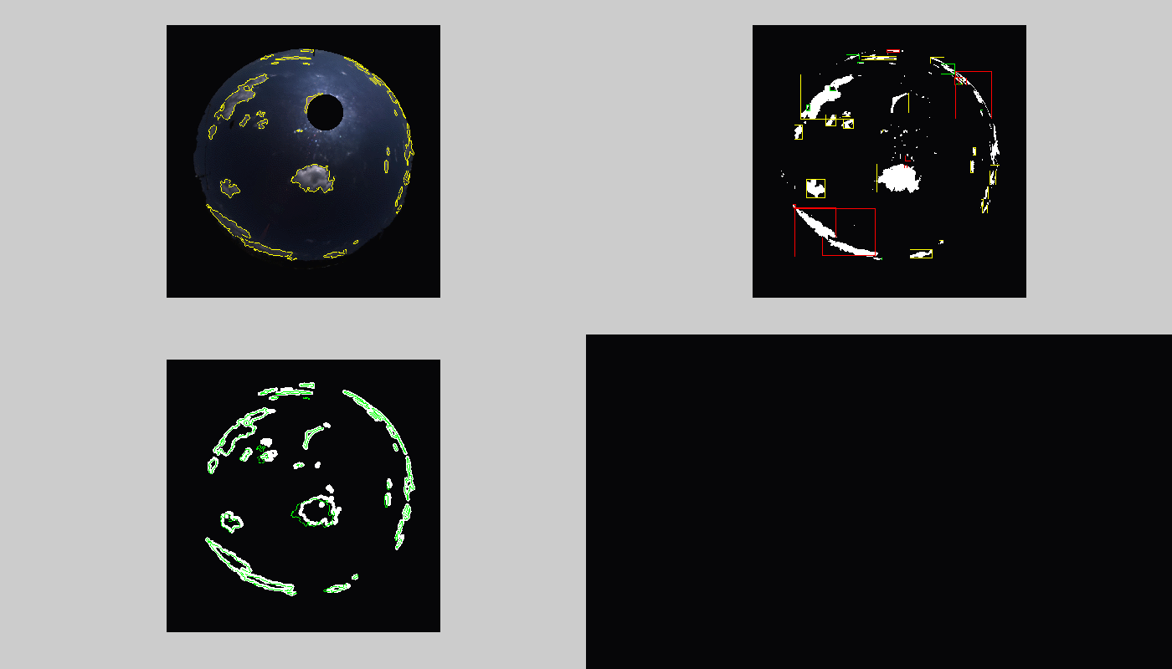
Cloud Tracking System
Real-Time Prediction
Sun position is estimated and tracked
Tracks are initialized
On-line Camera Feed
Processed Image
Green contours represent cloud position at time t (estimation)
White contours represent cloud position at time t + 3 mins (prediction)
Cloud Motion Estimation & Prediction

Slide 6
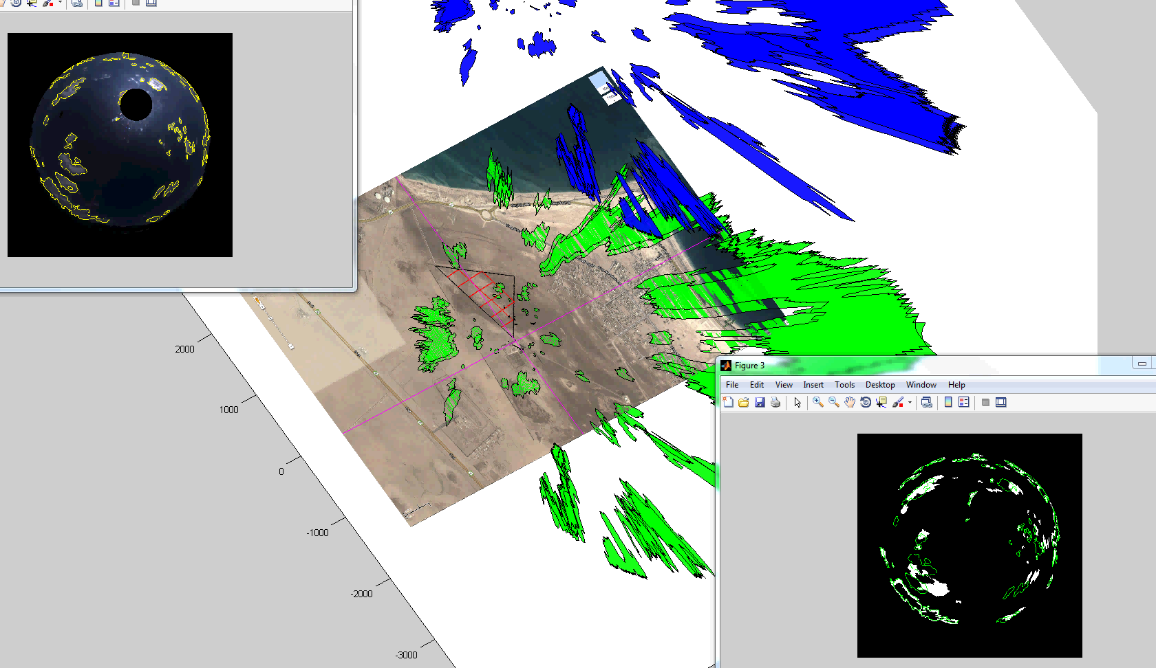
Cloud Tracking System
Cloud Shadow Location Prediction
Blue object represents predicted cloud position 3 min ahead.
Greed object represents predicted cloud shadow location 3 min ahead.

Slide 7
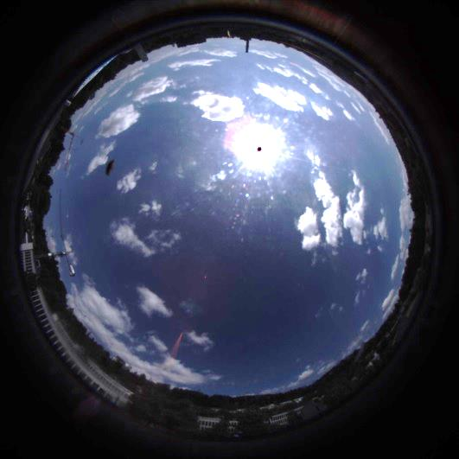
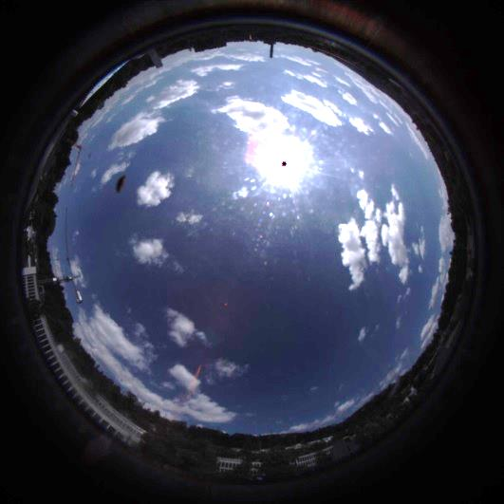
Cloud Tracking System
Irradiation drop Prediction
11:53:04
11:53:55
GHI Model
GHI Measurement

Slide 8
Cloud Tracking System
Particulars
The described system is a prototype. ABB agrees to install the system at no costs, and provides the costumer the forecast that is generated by the system.
The client should determine the quality of the forecast or whether the information provided can be used to make operability decisions.
ABB research team requires support from the client regarding access to data (e.g. measurements from sensors such as current, voltage, power, GHI, DNI, etc)
No IP will be generated from or shared with the collaboration. ABB owns the IP of the system.
ABB remains the sole owner of the system and data. However, it provides the data to the costumer at no cost.
Scientific publication from the collaboration is possible, subject to the discussion/agreement with client team and ABB management.

